Slide 1
Cricket League and Teams

Slide 2
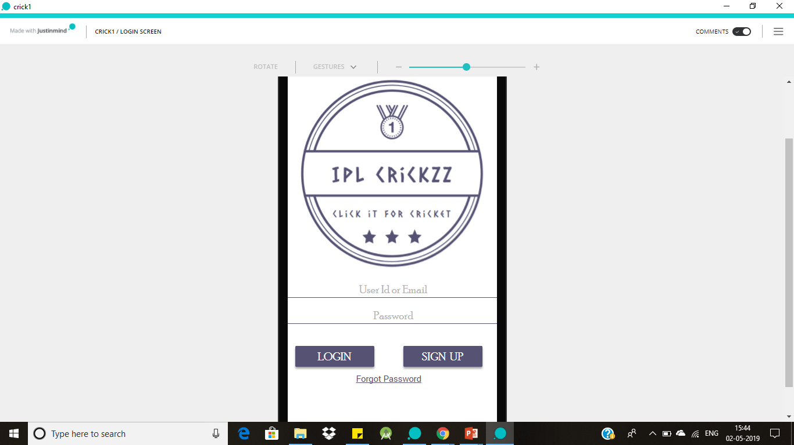
Login Screen
This Screen allows the user to create the account in the application and once the account is created user able to login into the application using login credentials.
If the user forgot the application credentials using forgot Password option they can retrieve the account.

Slide 3
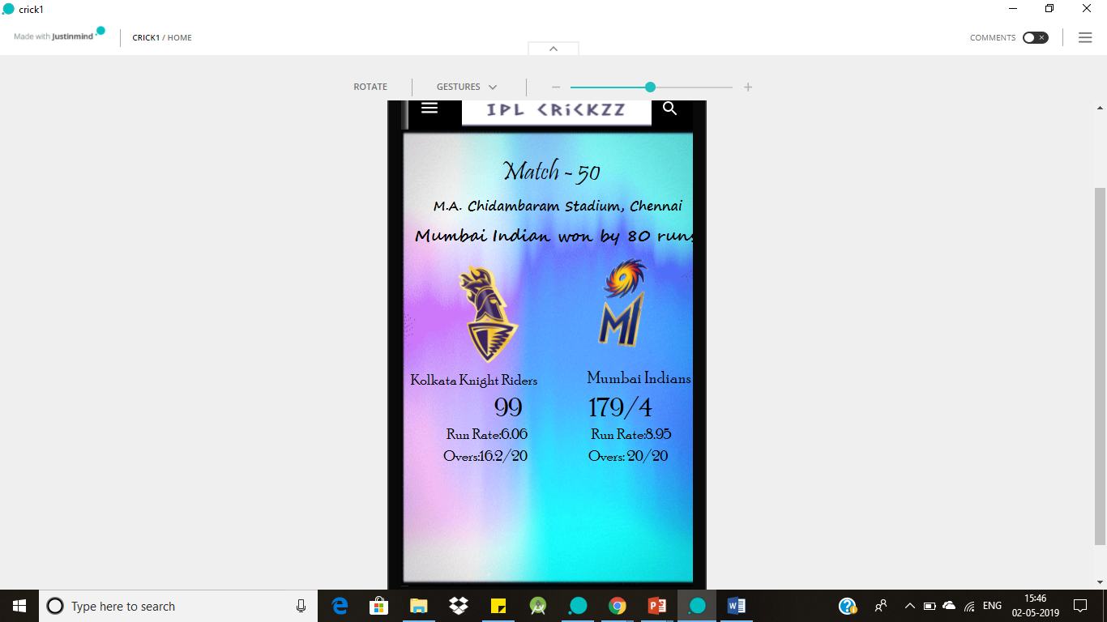
Home Screen
On Home Screen we can see the league matches schedule and live score of the ongoing match. In a short way we can say all the updates of the league can see on the Home Screen.

Slide 4
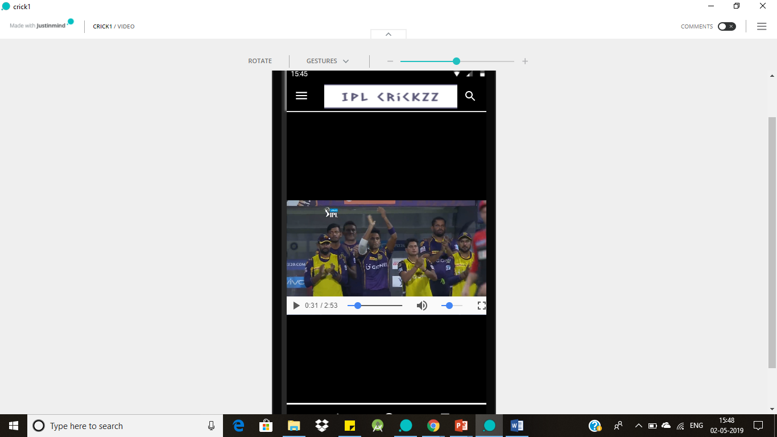
Videos Screen
In this screen application shows all the videos related to match reviews, Highlights of the match and also reviews of the cricket experts on the ongoing match.
User can easily switch from one video to another just by clicking on the video.

